Slide 1
MVP Kit for Customer Self Service Portal
FD Advices

Slide 2
Agenda
Service Digitization - Customer Self Service Portal
Retails Liabilities
Workflows
MVP Visuals
FD Advices Generation

Slide 3
Service Digitization - Customer Self Service Portal
The Business Need
Customer shall be able to raise service request himself / herself in following category with appropriate identification and authentication List of service request as follows:
FD Advices Generation
Authentication via Registered Mobile Number OTP
No Authorization for FD Advices Generation self service request
Solution Overview
The YES RAPIDO based Customer self service portal will be used across various business units such as – retails assets, retails liabilities and credit card, etc

Slide 4
MVP Visuals

Slide 5
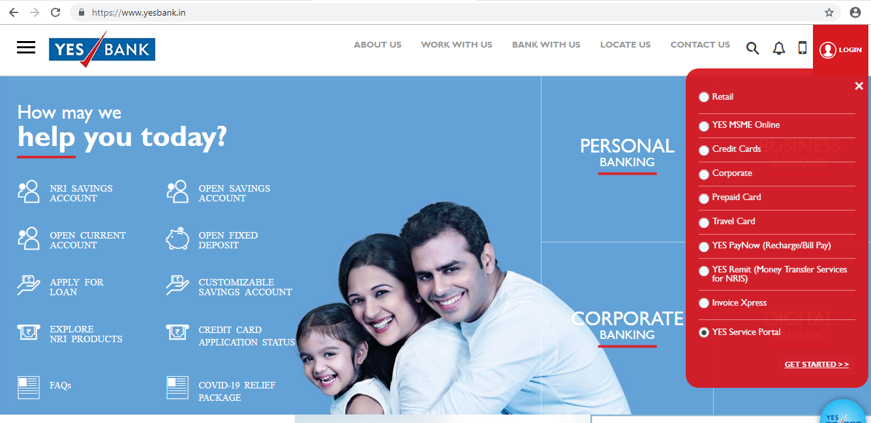
Self Service Center - Navigation
Notes:
In https://www.yesbank.in/ portal, click on Login and then click on Service Center link

Slide 6
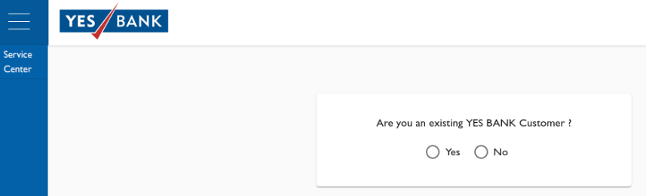
Customer Relationship Selection
Notes:
Customer will have to select, if he/she is an Existing Customer
If Yes, Customer will be rerouted to Service selection portal
If No, Customer will be displayed the existing products

Slide 7
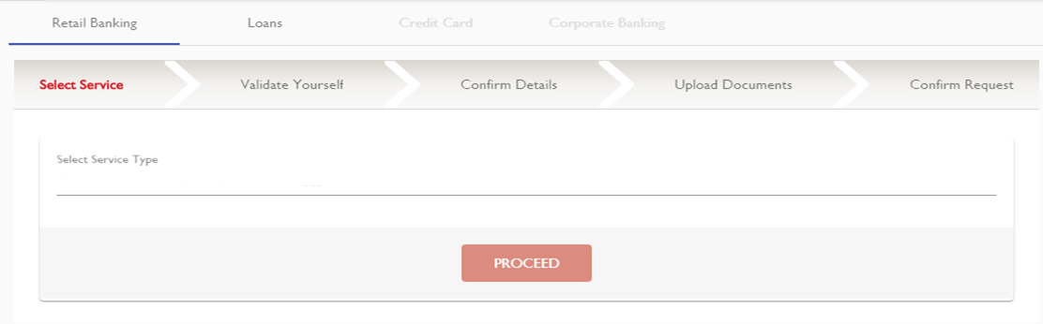
Customer Relationship Selection
Fixed Deposits Advices Generation

Slide 8
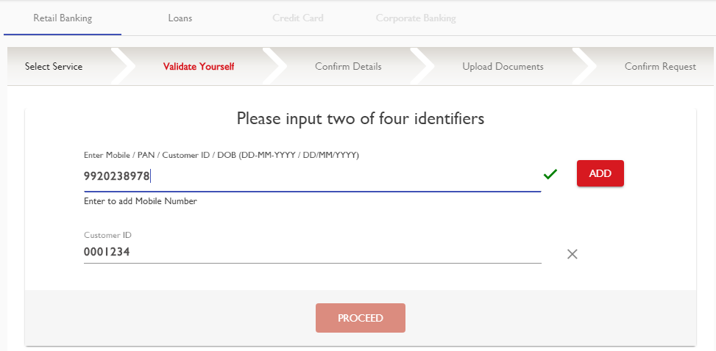
Customer Validation screen

Slide 9
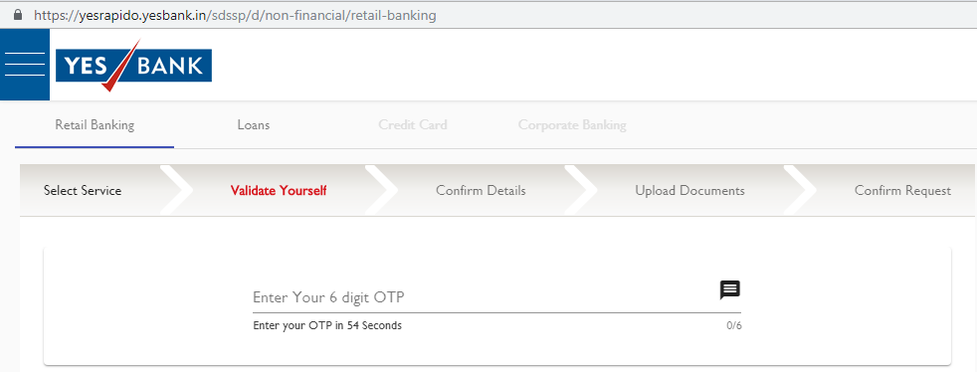
Enter OTP screen

Slide 10
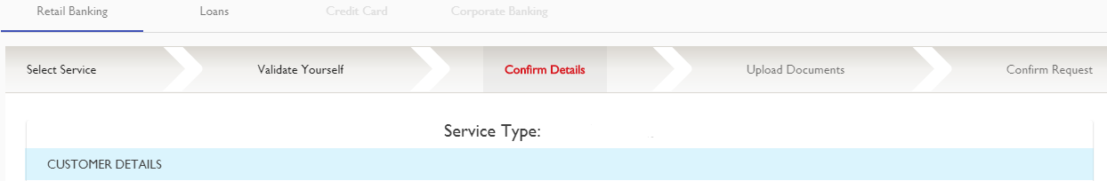
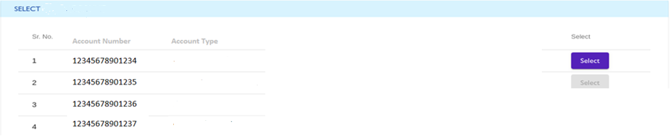
Fixed Deposits
Customer ID
1234589
Customer Name
Rahul Dravid
Amount
Fixed Deposits
50000
Fixed Deposits
100000
Fixed Deposits
200000
Fixed Deposits
25000
NEXT

Slide 11
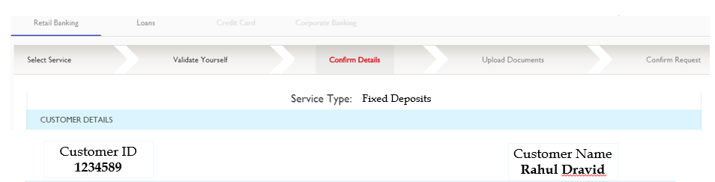
Service Type - Current Account / Saving Account Statement

Slide 12
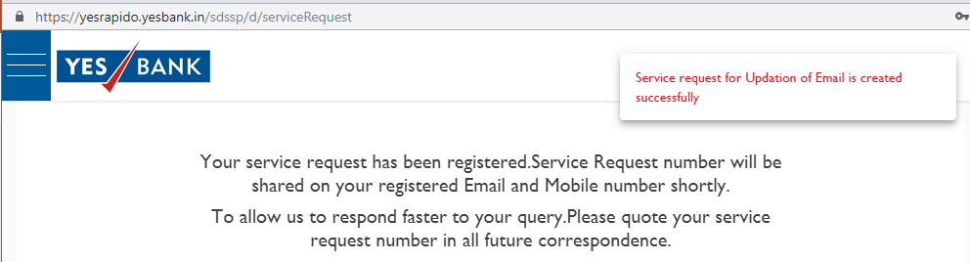

Slide 13
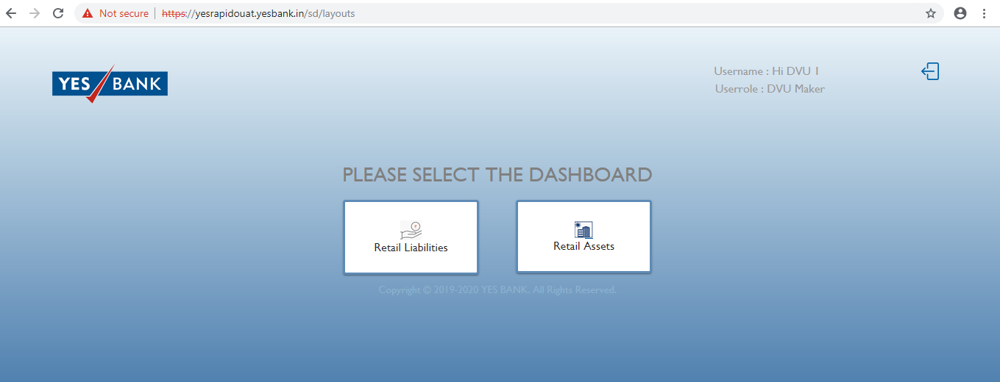
YES RAPIDO – SR ID on DVU Portal Menu
Notes:
Once the SR is created in Yes-Rapido portal, the DVU will be required to log-in into the DVU portal, go to Reports in the Side Menu to see all the reports

Slide 14
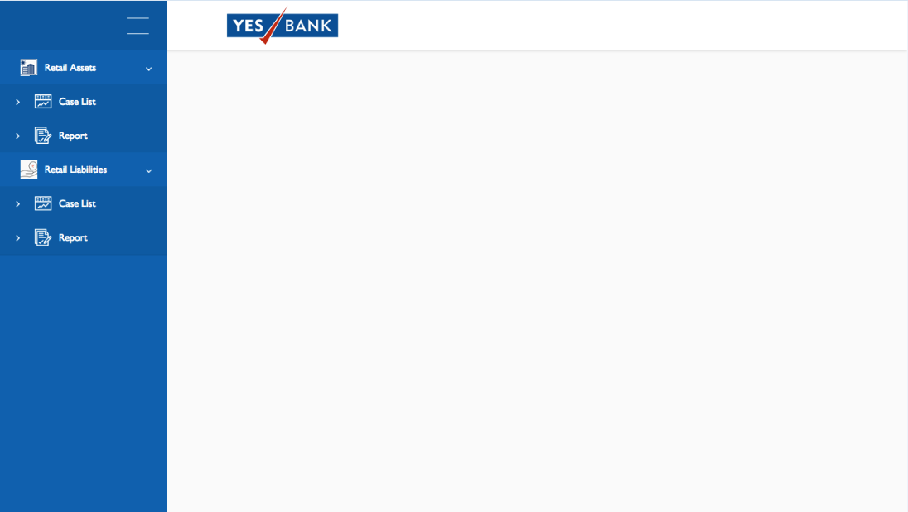
YES RAPIDO – SR ID on DVU Portal Menu
Notes:
Once the SR is created in Yes-Rapido portal, the DVU will be required to log-in into the DVU portal, go to Reports in the Side Menu to see all the reports

Slide 15
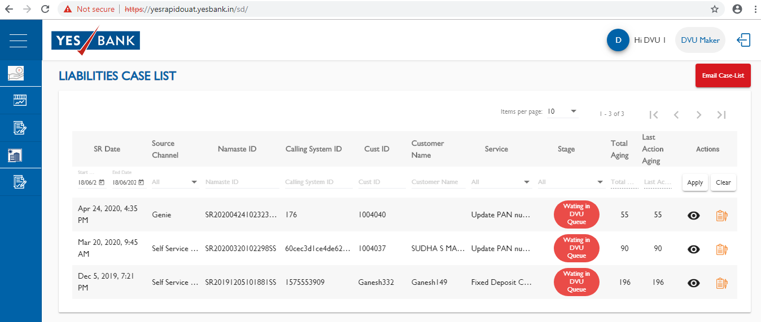
DVU Portal – Liabilities Case List
Notes:
The Report will be seen as above.
The eye icon will give details of each SR that is logged here.
The CRM User will need the CRM ID from Column 3 to be entered into CRM System.

Slide 16
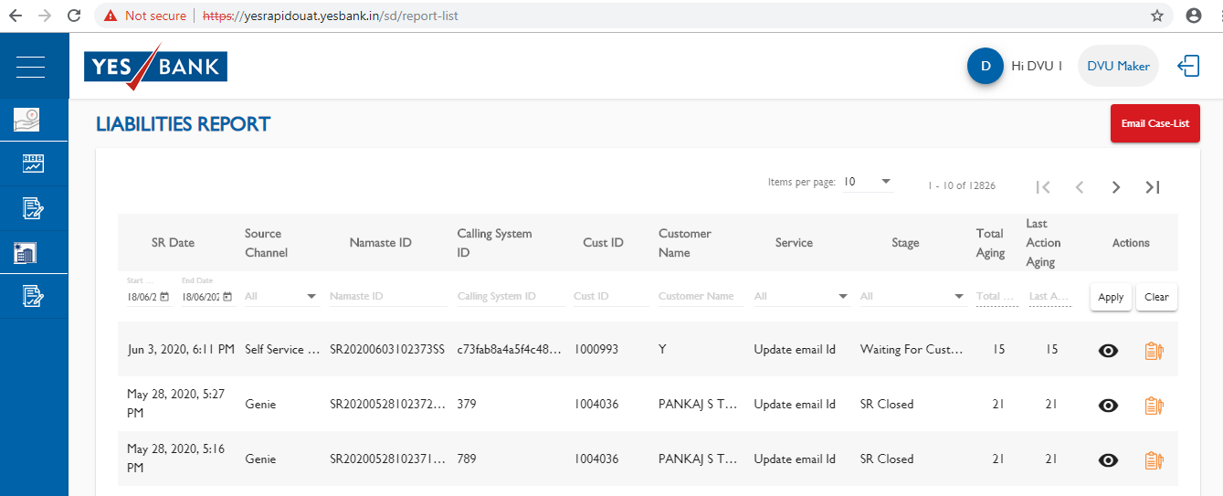
DVU Portal – Liabilities Report
Notes:
The Report will be seen as above.
The eye icon will give details of each SR that is logged here.
The CRM User will need the CRM ID from Column 3 to be entered into CRM System.

Slide 17
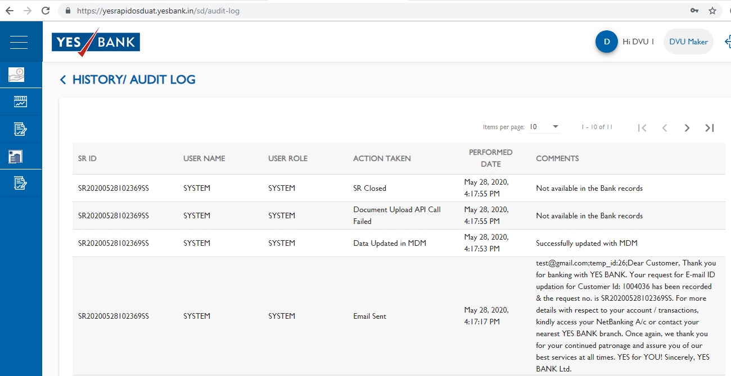
DVU Portal – History / Audit Log
Notes:
The Report will be seen as above.
The eye icon will give details of each SR that is logged here.
The CRM User will need the CRM ID from Column 3 to be entered into CRM System.

Slide 18
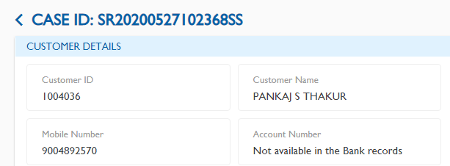
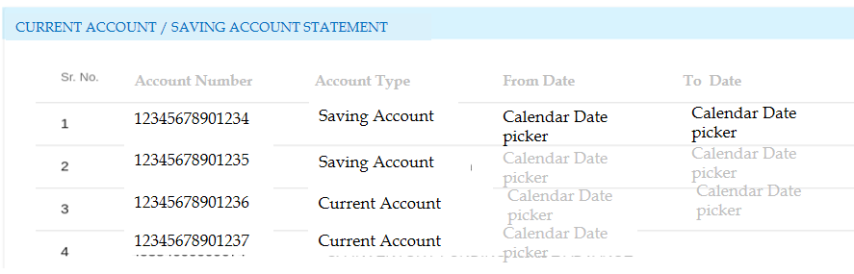
DVU Portal – View Details
Notes:
The Report will be seen as above.
The eye icon will give details of each SR that is logged here.
The CRM User will need the CRM ID from Column 3 to be entered into CRM System.

Slide 19
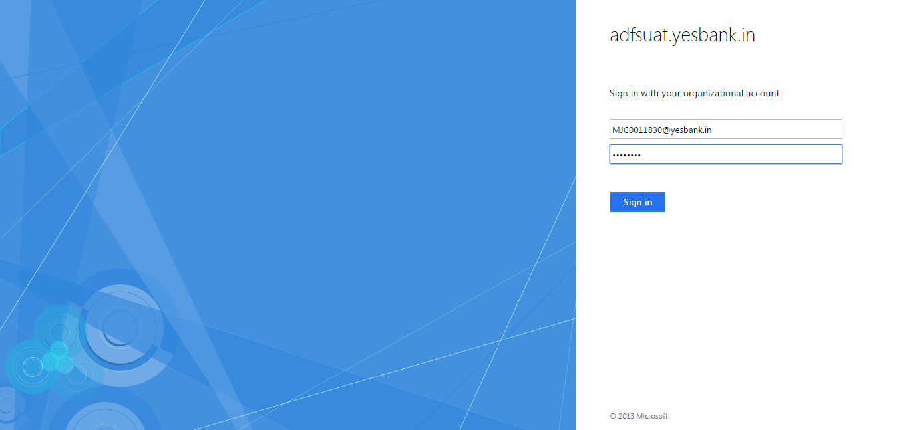
YES RAPIDO – CRM System Login
Notes:
The CRM User will need to log in to the below URL to access into the CRM system.
https://yespulseuat.yesbank.in

Slide 20
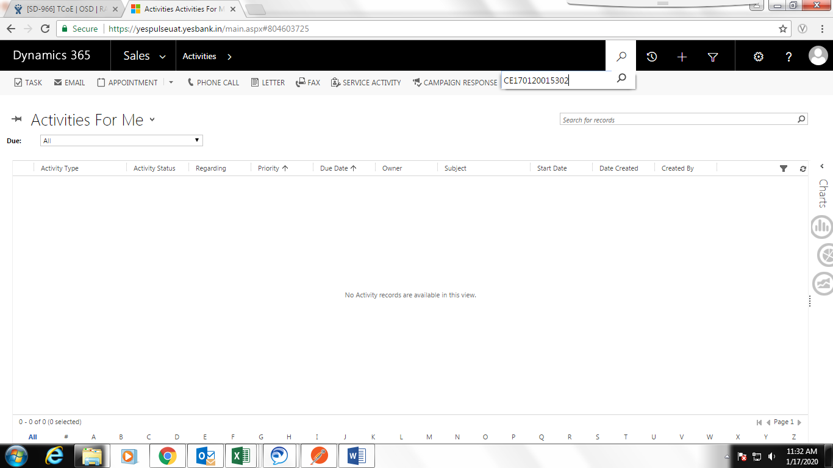
Case ID Search
Notes:
The CRM user will have to search for the CRM ID (the CRM ID will be retrieved from DVU Portal) in the Global Search at the top right as highlighted.

